Slide 1
YOUR TASK:
Write a power of either the House, the Senate, or both on a post it note and place it in the appropriate place on the Venn Diagram.
Work together as a class to ensure that all exclusive and shared powers are included.
Exclusive powers of the Senate
Exclusive powers of the House
Exclusive powers of the Senate
Exclusive powers of the House
Shared powers
Shared powers
Confirm appointments
Initiate money bills
Pass legislation
Override veto
Initiate constitutional amendments
Declare a war
Confirm a new VP
Ratify treaties
Impeachment
Try cases of impeachment
Elect president if EC is tied
Elect vice-president if EC is tied

Slide 2
Enquiry Question: How do the roles and powers within Congress differ?

Slide 3
Learning Outcomes
To identify the shared and exclusive powers of the Senate and the House of Representatives
To analyse the impact of these
To evaluate the extent to which the chambers of Congress are equal

Slide 4
YOUR TASK:
Read the handout “House of Representatives vs Senate”.
Highlight key similarities.
Underline key differences.

Slide 5
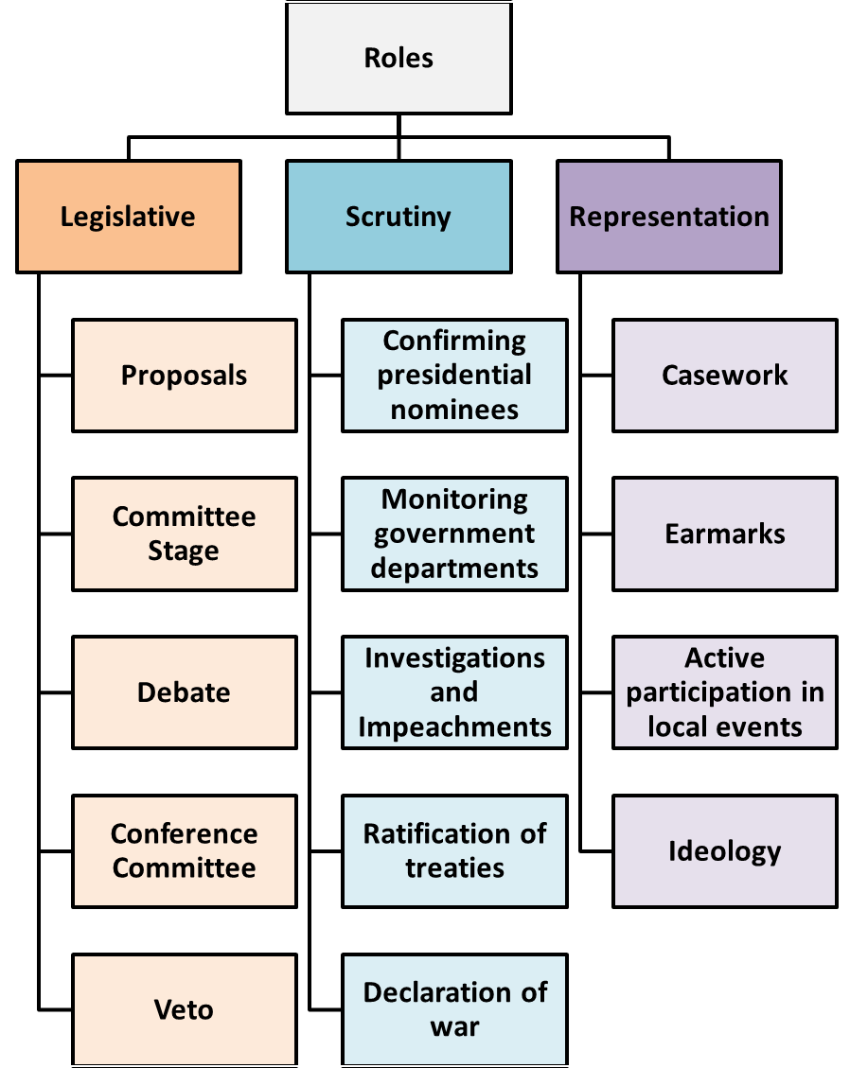
Roles of Congress
YOUR TASK:
Mind map the roles of Congress.
Annotate your mind map to explain each role and function.
Colour code each role to show whether it is;
a) an exclusive role/power of the House
b) an exclusive role/power of the Senate
c) a shared power of both the House and the Senate

Slide 6
Learning Outcomes
To identify the shared and exclusive powers of the Senate and the House of Representatives
To analyse the impact of these
To evaluate the extent to which the chambers of Congress are equal

Slide 7
How and why are the two chambers of Congress different?
Watch the video: Crash Course – Bicameral Congress.

Slide 8
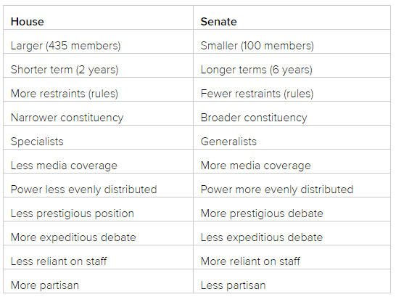

Slide 9
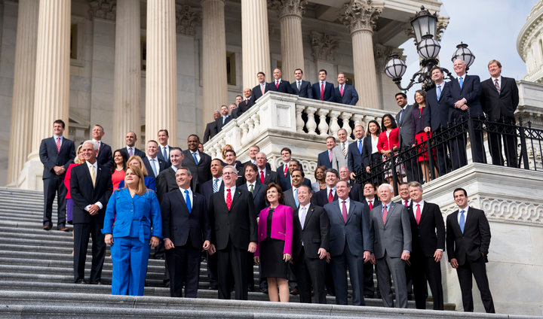
Spotlight: 115th Congress
The One Hundred Fifteenth United States Congress is the current meeting of the legislative branch of the United States federal government, composed of the Senate and the House of Representatives.
It meets in Washington, D.C. from January 3, 2017, to January 3, 2019, during the final weeks of the Obama presidency and the first two years of Donald Trump's presidency.
The November 2016 elections maintained Republican control of both the House and Senate.
YOUR TASK:
Find examples of recent headlines involving;
the Senate
the House
Congress as a whole
Which roles/powers are these headlines examples of?
Share your headlines and explain them to the class.

Slide 10
Learning Outcomes
To identify the shared and exclusive powers of the Senate and the House of Representatives
To analyse the impact of these
To evaluate the extent to which the chambers of Congress are equal

Slide 11
To what extent are the two chambers of Congress equal in power and influence? (15)

Slide 12
To what extent are the two chambers of Congress equal in power and influence?
Evidence that the Senate and the House are equal in power includes:
both chambers have equal power in the passage of legislation, constitutional amendments, overrides of presidential vetoes and declarations of war
Evidence that the House is more powerful than the Senate includes:
the House initiates impeachment proceedings
the House begins consideration of money bills
the House elects the president if there is not a majority in the Electoral College

Slide 13
To what extent are the two chambers of Congress equal in power and influence?
Evidence that the Senate is more powerful than the House includes:
the Senate’s exclusive powers of appointment confirmation and treaty ratification are often of considerable consequence for the political system
the increased use of the filibuster, and the consequent need for a ‘super-majority’ to pass almost any legislation, means the president’s legislative strategy is usually focused on the Senate
the Senate delivers the final verdict in impeachment proceedings
There are only 100 Senators, compared to 435 House representatives.
Senators have six year terms, compared to the two year terms of the House.

Slide 14
To what extent are the two chambers of Congress equal in power and influence?
Evidence that the Senate is more powerful than the House includes:
The Senate’s exclusive powers are more significant, especially the ratification of treaties and the confirmation of presidential nominees.
The frequent use of the filibuster and the consequent need for a 60 vote ‘supermajority’ mean that the passage of legislation is more problematic than in the House, and gives senators of both parties a degree of leverage. The loss of the Democrats’ supermajority, after the special election in Massachusetts in January 2010, meant that Democrats in the Senate were able to exert more influence over the final shape of health care reform than their colleagues in the House.
It is not uncommon for representatives to seek to become senators, but next to never the other way.
Serious congressional presidential and vice-presidential candidates have almost always come from the Senate, e.g. Obama, Biden and McCain.

Slide 15
Which is more important – the House or the Senate? (15)
YOUR TASK:
Read the model answer to a similar exam question.
Annotate the answer as a teacher would, for example focusing on accuracy, structure, examples and written expression.
Use the mark scheme to award a level and a mark.
Write a brief justification for your mark to this student.
What were the strengths of this answer?
How could this answer be improved?

Slide 16
How did they do?
Use the mark scheme to assess the answer.
Levels | Descriptors
Level 3 (11-15 marks) | Full and developed knowledge and understanding of relevant institutions, processes, political concepts, theories or debates. Good or better ability to analyse and explain political information, arguments and explanations. Sophisticated ability to construct and communicate coherent arguments, making good use of appropriate vocabulary.
Level 2 (6-10 marks) | Satisfactory knowledge and understanding of relevant institutions, processes, political concepts, theories or debates. Sound ability to analyse and explain political information, arguments and explanations. Adequate ability to construct and communicate coherent arguments, making some use of appropriate vocabulary.
Level 1 (1-5 marks) | Limited knowledge and understanding of relevant institutions, processes, political concepts, theories or debates. Poor ability to analyse and explain political information, arguments and explanations. Weak ability to construct and communicate coherent arguments, making little or no use of appropriate vocabulary.

Slide 17
Learning Outcomes
To identify the shared and exclusive powers of the Senate and the House of Representatives
To analyse the impact of these
To evaluate the extent to which the chambers of Congress are equal

Slide 18
Plenary: House or Senate
YOUR TASK:
You will be shown a statement, simply decide whether it describes the House or the Senate.

Slide 19
The number of members from each state is proportionate to the size of the state.

Slide 20
Up to 1913 (the 17th amendment), members of this chamber of congress were elected by state legislature and not by the people.

Slide 21
Only members of this chamber in congress can initiate money bills.

Slide 22
Only members of this chamber of congress can bring impeachment proceedings against a member of the judiciary or the executive.

Slide 23
Members serve 6 year terms.

Slide 24
Members of this chamber in congress must be US citizens for at least 9 years

Slide 25
Only members of this chamber of congress can ratify treaties.

Slide 26
Members of this chamber of congress from the same state are not up for elections at the same time

Slide 27
The speaker of this chamber of congress is the most powerful person in US politics, next to the president and the vice president.

Slide 28
Members of this chamber in congress must be at least 35 years old.

Slide 29
Each state sends two representatives to this chamber of congress.

Slide 30
Members of this chamber try members of the executive and the judiciary in cases of impeachment

Slide 31
Members of this chamber of congress serve 2 year terms.

Slide 32
Members of this chamber must be at least 25 years old

Slide 33
Members of this chamber of congress must be US citizens for at least 7 years.

Slide 34
Members of this chamber of congress have the power to approve senior executive and judiciary appointment.

Slide 35
Homework
Application Task:
To what extent are the two chambers of Congress equal in power and influence? (15)
Flipped Learning Preparation Task:
Composition of Congress Task
Stretch & Challenge Task
Article: Membership of the 115th Congress; A Profile

